Slide 1
HS 200: Environmental Studies
Humanities and Social Sciences
Instructor- S. Pattanaik
Topic- ‘Environmentalism of the Poor’ debate
Sub-themes
History of Environmentalism
North-South dimension of environmentalism
Environmentalism of the Poor
Ecological conflicts
Iron Triangle concept

Slide 2
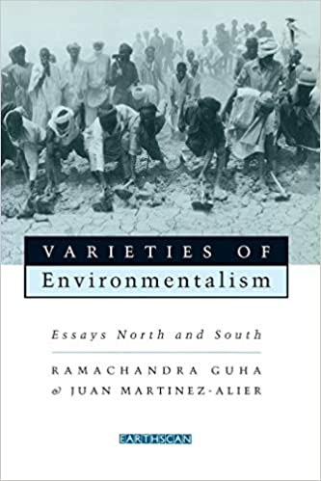
Reading
‘Environmentalism of the Poor’ – Extracted from the book Varieties of Environmentalism- Essays North and South (Chapter-1)
By- Ramachandra Guha and
J. Martinez- Alier, 1997.

Slide 3
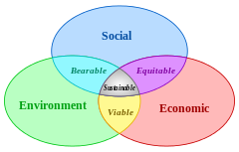
Sustainable development

Slide 4
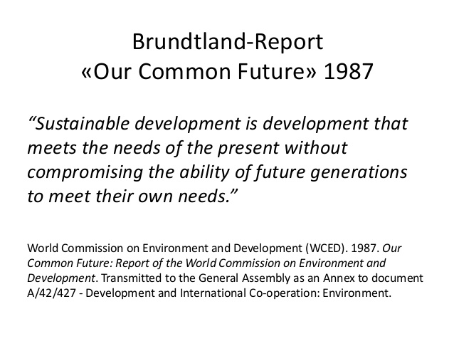
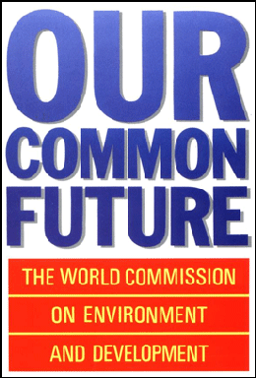
Sustainable Development

Slide 5
WCSD (World Commission on Sustainable Development) 1987
Brundtland Commission Report (1987)
Report on ‘Our Common Future’-1987
Definition on S-D (ECED)
The definition provides two concepts:
1. The concept of present needs (Needs of the World’s poor to which overriding priority should be given);
2. The idea of limitations imposed by the state of technology & social organization on the environment’s ability to meet present & future needs.

Slide 6
Dimensions of Development
ECONOMIC
POWER
SD
SOCIAL
ENVIORNMENTAL
SD: Field of Sustainable Development

Slide 7
S-D on Envirment and Development
Access?
Control?
Equity?
Sustainability Conflicts?

Slide 8
Conflicts within Sustainable Development
Between:
the present and future generations
human well-being and the protection of nature
the poor and rich
a local and a global focus: ‘Here’ and ‘Elsewhere’

Slide 9
Sub-themes
1. History of Environmentalism
2. North-South dimension of environmentalism
3. Environmentalism of the Poor
4. Ecological conflicts
5. Iron Triangle

Slide 10
1.
History of Environmentalism

Slide 11
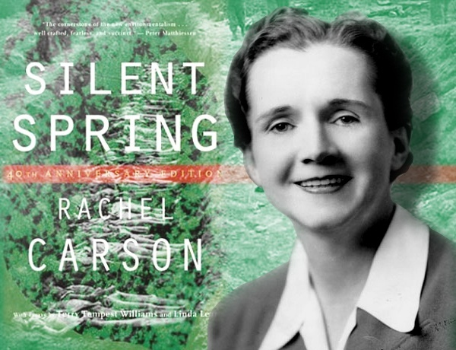
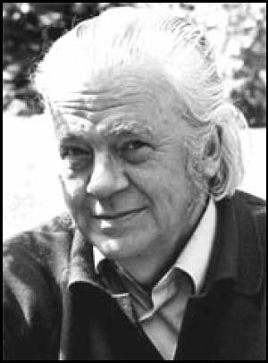
Environmental awareness in the Globe and in India
Earlier in the 20th century:
British attempts to improve public health,
water supplies, sanitation;
German science of conservation
biology, forestry;
1960s Ecological approach to Nature
Chemicals in the food-chain,
Rachel Carson: Silent Spring, 1962
‘Buddhist economics’ Intermediate, Technology,
E. F Schumacher: Book→ Small is Beautiful
(Economics, as if people mattered)
One of the 100 most influential books published after
World War II

Slide 12
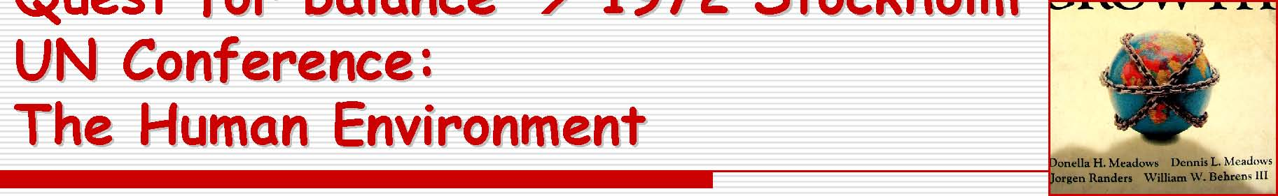
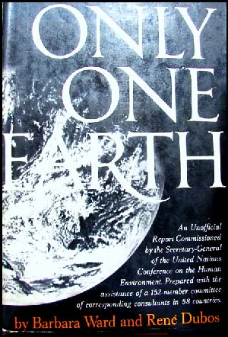
1972 Stockholm provided the foundation for -Global environmental governance -Preservation of natural habitats -Checking trans-boundary pollution -Stopping environmental degradation .
Indira Gandhi: ‘Poverty is the greatest polluter’

Slide 13
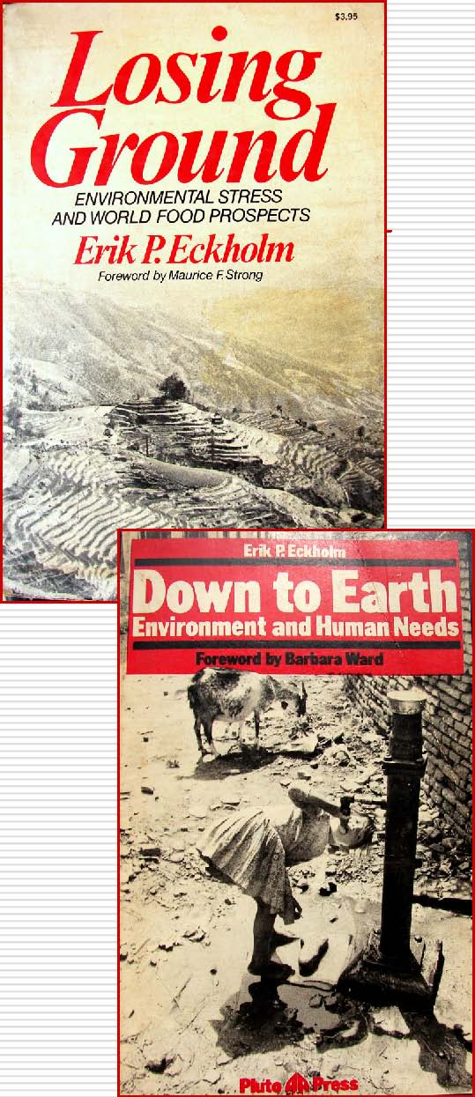
Global impact of Stockholm
Series of UN conferences through 1970s:
on Population, Food, Women, Human
settlement, Water, Desertification, Primary
health care, World development
Regulation: CITES (1973) trade in wildlife
Eric Eckholm’s Book Losing Ground:
Environmental Stress and World Food
Prospects, 1976
(politics of soil conservation, deforestation)
Down to Earth, 1982

Slide 14
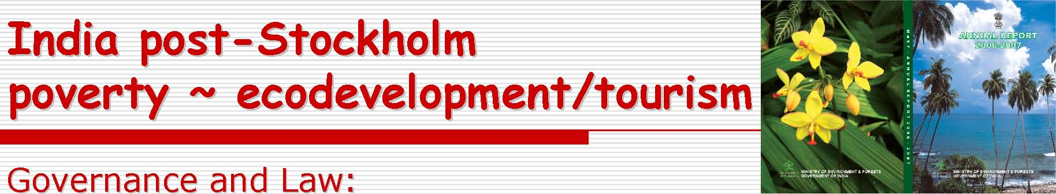
ND Tiwari Committee NCEPC 1972
- ‘ NCEPC→ Department under DST, 1980→ Ministry of Environment and Forests
Education:
- 1973-75 Environmental Studies introduced (under the aegis of the British Council) in selected primary schools in Delhi, Chennai. Using the environment as a learning resource.
Took 25 years and a SC judgment for ES to be introduced in higher education

Slide 15
December 1984: Bhopal disaster: Indian environmental policy, before and after
Widespread shock; Later, sense of people being abandoned by
government
Pre-Bhopal: specific laws and institutional mechanisms
Wildlife Protection Act, 1972 National Parks
Forest (Conservation) Act, 1980 (amended 1988)
Water (Prevention and Control of Pollution) Act, 1974
Air (Prevention and Control of Pollution) Act, 1981
Setting up Central, State Pollution Control Boards to oversee Acts
Post-Bhopal: more broad-based laws
Environmental Protection Act, 1986.
National Conservation Strategy and Policy Statement on the
Environment, 1992

Slide 16
2.
North-South dimension of Environment-or Environmentalism

Slide 17
First (North) & Third (South) World Environmentalism
Ecology of Affluence
Southern challenge
(Environmentalism of the Poor)
Guha, Ramachandra and Matinez-Alier, 1997
(Varieties of Environmentalism)
Environmentalism of the North is refereed as “full stomach” environmentalism and the environmentalism of the south is called as “empty – belly” environmentalism.

Slide 18
Some Varieties of Environmentalism in the Globe North-South or West-East Environmentalism
Materialist Non-Materialist
(In Affluent reaction against the Cultural shift to post-
Countries) increased impact of the materialist ‘quality of
effluents of affluence, i.e., life’ values and increa- the environmental justice sed appreciation of
movement in US, the natural amenities,
anti-nuclear movement.
(In poor The environmentalism of ‘Biocentric’ eastern
countries) the poor, i.e., the defence religions
of livelihood, & communal
access to natural resources
Reaction against environmental Essentialist eco- degradation caused by poverty, feminism
population growth..
18

Slide 19
The environmentalism of the North is refereed as “full stomach” environmentalism and the environmentalism of the south is called as “empty – belly” environmentalism.
Environmentalism of the Southern Word (India): …since 1960s..
Chipko, Tehri, SSP, Silent Valley, Mining issues and conflict, Singur, Coke Plachimada , Jaitapur sruggle ..

Slide 20

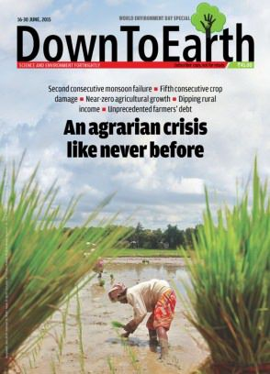
3. Environmentalism of the Poor
The first lesson is that the main source of environmental destruction in the world is the demand for natural resources generated by the consumption of the rich (whether they are rich nations or rich individuals and groups within nations)….
The second lesson is that it is the poor who are affected the most by environmental destruction.
(Anil Agrawal, 1986, Founder of CSE, Delhi , Down to Earth Journal)
https://www.cseindia.org/

Slide 21
Environmentalism of the Poor: Ramachandra Guha
Page no- 4-10 (Reading)
Instances: Resistance against KPL, Karanataka
1984
Chipko Movement -1960s
In the global and Indian history of
Environmentalism of the poor-
Exp: Chipko Movement
Another Example- KPL, Karnataka
Chipko, KPL, NBA- 1960s- 1980s:
witnessed series of popular movements in
defense of community rights to natural resources.
21

Slide 22
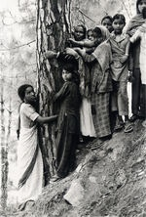
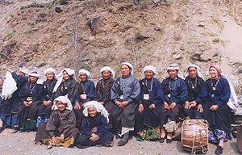
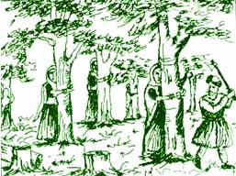
Chipko Movement
The movement’s major success came in 1980, when an appeal from Bahuguna to Indian Prime Minister Indira Gandhi resulted in a 15-year ban on commercial felling in the Uttarakhand Himalayas. Similar bans were enacted in Himachala Pradesh and the former Uttaranchal.

Slide 23
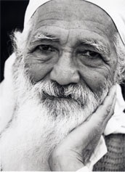
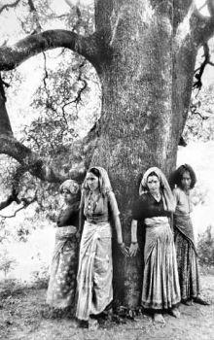
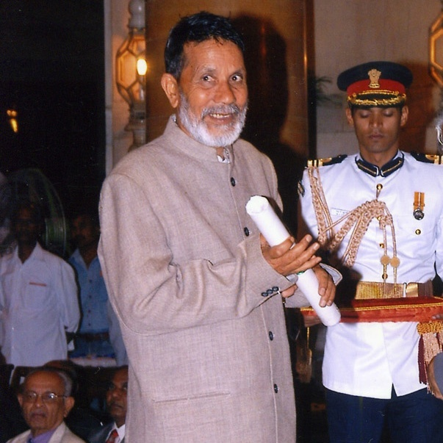
Chipko: Government, Paper Mills / Loggers, People
Sunderlal Bahuguna
Chandi Prasad Bhatt, Dasholi Gram Swarajya Sangh (DGSS, established in 1964)

Slide 24
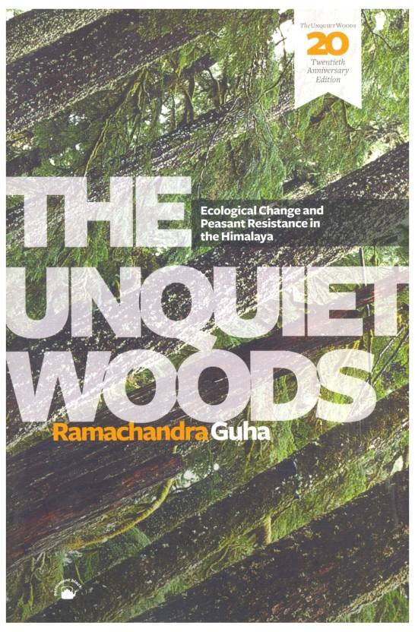
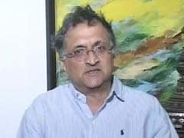
Environmentalist and social historian Ramachandra Guha, author of The Unquiet Woods, “Chipko is the latest in a long series of peasant protests going back to the turn of the century against commercial forestry in the Uttar Pradesh Himalaya in the Uttar Pradesh Himalaya”

Slide 25
4. Various instances of Ecological conflicts in India- Strong Environment-Society Interactions- ‘Environmentalism of the poor’
Chipko- Garhwal Himalayas
Dams and mutli-purpose projects- Tehri, Narmada,
Silent Valley
Plachimada – Kerala (struggle aganst Hindustan Coca Cola Beverages Private Limited ,HCCBPL)

Slide 26
Iron Triangle approach
Iron Triangle approach: Class and the use/ abuse of natural resources (Guha and Gadgil, 1995)
“the pattern of development can be attributed to the dominance in Indian society of an ‘iron triangle’ approach of politicians and bureaucrats who use public resources to extend patronage to and receive support from industry, large landowners and urban middle class populations”. ..called as Resource omnivores
Resource Omnivores, Ecosystem People, Ecological Refugees- form the iron triangle
Notes:
Resource Omnivores, Ecosystem People, Ecological Refugees- form the iron triangle

Slide 27
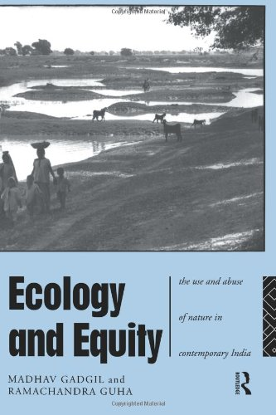
Omnivores: industrialists, rich farmers, urban middle classes, politicians (the pattern of development can be attributed to the dominance in Indian Society of an ‘Iron Triangle’ of .. Who use public resources to extend patronage to and receive support from industry…
Ecosystem people: Rural, those who rely on natural resources (small and marginal farmers, hill peasants, landless labour, tribals, pastoralists)
Ecological refugees: Displaced, evicted, resettled, impoverished urban migrants

